Slide 1
FRAUDULENT Analysis And Detection

Slide 2


CONT ENTS
Background
Company & Business Problem Introduction
Project Proposal
Data
Dataset Introduction & Preparation
Descriptive Analysis
Model
Algorithm Explanation
Model Building & Evaluation
Summary
Model Results Summary & Insights
Business Recommendation

Slide 3
Background
1
Company & Business Problem Introduction
Project Proposal

Slide 4


Company & Business Problem Introduction
Canadian e-commerce giant
Customers from all around the world
Increase in fraudulent activities

Slide 5


Company & Business Problem Introduction

Slide 6


Project Proposal
Professional consultant
Build a model to predict and prevent fraudulent activities in real time
Exploratory Data Analysis
Build baseline logistic model
Build logistic model
Optimize probability threshold
Drive insights and deliver recommendation

Slide 7
Data
2
Dataset Introduction & Preparation
Exploratory Data Analysis

Slide 8
Dataset Introduction & Preparation
Dataset Sample & Dictionary
Data Fields | Definition
signup_time | The time when the user created her account (GMT time)
purchase_time | The time when the user bought the item (GMT time)
purchase_value | The cost of the item purchased (USD)
device_id | The device id. You can assume that it is unique by the device. I.e., transactions with the same device ID means that the same physical device was used to buy
source | User marketing channel: ads, SEO, Direct (i.e. came to the site by directly typing the site address on the browser).
browser | The browser used by the user.
sex | User sex: Male/Female
age | User age
ip_address | User numeric IP address
class | This is what we are trying to predict: whether the activity was fraudulent (1) or not (0).

Slide 9
Dataset Introduction & Preparation
Feature Engineering
'signup_weekofyear': the week of year for sign-up time
‘purchase_weekofyear':the week of year for purchase time
'signTOpurchase': time difference between sign up and purchase
‘device_shared': how many times a device is shared
‘ip_shared': how many times a IP is shared
‘country_shared':how many times visited from a country in total

Slide 10
Dataset Introduction & Preparation
Train Test Split
Use one hot encoding to transform categorical variables into dummy variables.
Split dataset into train (75%) and test (25%) set.
Use oversampling to balance training set.
Balanced training set with fraudulent rate of 33% is found to yield the best result.

Slide 11
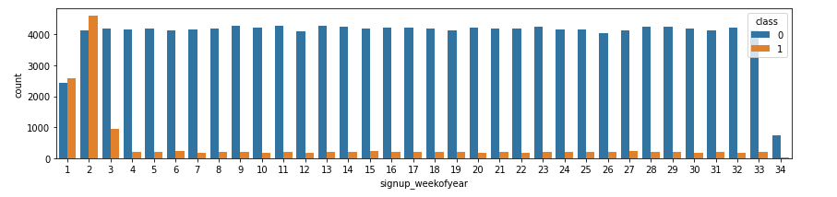
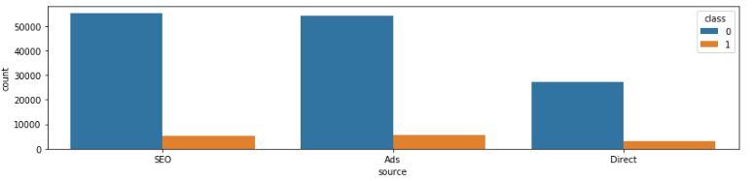
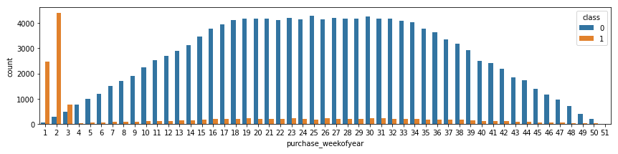
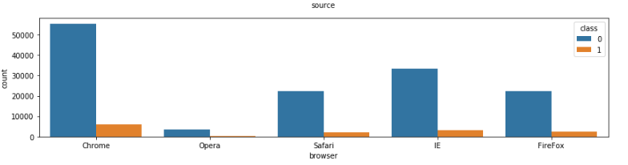
Exploratory Data Analysis
Time Frame
Distribution of source & browser
Fraudulent activity mostly occurs in the first three weeks of the year.
SEO and Ads have a higher frequency of fraudulent activity.
Google Chrome has the most number of fraudulent activities.

Slide 12
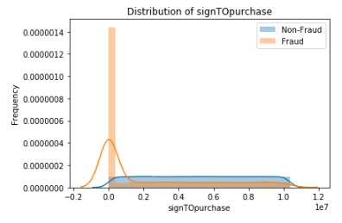
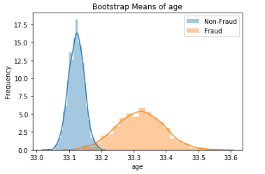
Exploratory Data Analysis
Distribution of signTOpurchase
Distribution of age
Fraud tends to happen when a purchase is made within 24 hours of the sign-up.
The fraudulent activities have a higher frequency around the age of 31 to 33.

Slide 13
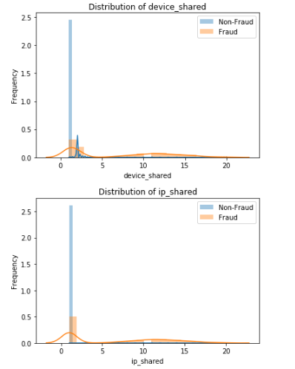
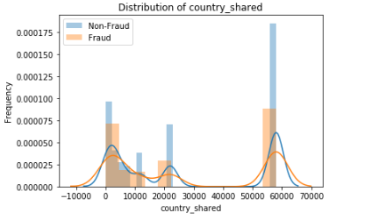
Exploratory Data Analysis
Distribution of device_shared & ip_shared & country_shared
The more devices are shared, the more likely the activities are fraudulent. This is also true for IP address
The less visit from a country, the more likely purchase from this country is a fraudulent activity.

Slide 14
Model
3
Algorithm Explanation
Model Building & Evaluation

Slide 15
Algorithm Explanation
Show superior when the dependent variable is dichotomous.
Prevent overfitting as well as enhancing the accuracy.
Outperform ridge logistic regression on our dataset.
Lasso logistics regression

Slide 16
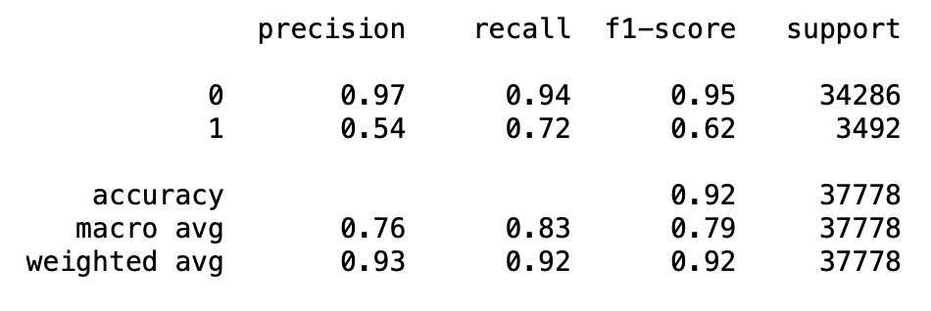
Model Building & Evaluation
Model Results
The final model yields 92% accuracy and 72% recall on the test set in identifying fraud with the threshold of 0.5.

Slide 17
Summary
4
Model Results Summary & Insights
Business Recommendation

Slide 18
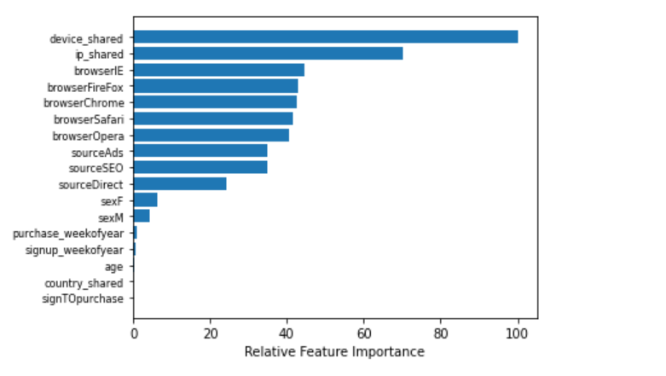
Model Results Summary & Insights
Relative Feature Importance
device_shared and ip_shared are the most important features.

Slide 19
Model Results Summary & Insights
The more a device is shared, the more likely the transaction would be fraudulent.
The more unique an IP address is, more likely the transaction would be fraudulent.
New IP address has a higher chance making a fraudulent transactions.
IE browser users tend to have a higher fraudulent probability.
SEO and Advertisement access seems to be responsible for most of the fraudulent cases.

Slide 20
Business Recommendation
Limiting the amount of users per device/IP
Banning IP/Device ID associated with fraudulent activities
Processing transactions based on probability

Slide 21
Thanks

